Slide 1
RGA meeting
ɸ electroproduction analysis : K_{s} K_{L} channel
20 Jan 2026
M. Ronayette, P. Chatagnon
Mathieu Ronayette
rgA - meeting
1/26
Mathieu Ronayette
21 Jan 2026

Slide 2
Analysis objective :
- Measurement of the cross section and diferential cross section of the electroproduction of ɸ in the K_{s} K_{L} channel
π⁺
e
e’
Ks
π⁻
q
ɸ
Kl
- Datas : nSidis RG-A inbending and
outbending fall 2018 + spring 2019
p
p’
Mathieu Ronayette
rgA - meeting
2/26
Mathieu Ronayette
21 Jan 2026

Slide 3
General informations
Datas :
nSidis Rg-A datas : fall2018 inbending
& outbending
Correction on π⁺ π⁻ vertex :
Vertex of π⁺ π⁻ are recalculated with the code
of Veronique Ziegler
Add some cut on :
→ Distance between vertex of π⁺ π⁻ < 3.5 cm
→ Distance between vertex Ks and e⁻ :
1.5 < Dist < 7.0 cm
because cτ_{Ks} = 2.68 cm
Cuts :
→ Selection of events with one
e⁻ , p , π ⁺ and π ⁻ in the final state. π ⁺ π ⁻ in FD.
→ Cut on invariant mass of π⁺ π⁻ with
0.4 < M_{inv}(π⁺ π⁻) < 0.6 GeV.
→ Cut on Missing Mass in the reaction
e p → e’ p’ K_{s} X with 0.4 < M_{issMass} < 0.6 GeV.
Mathieu Ronayette
3/26
Mathieu Ronayette
rgA - meeting
21 Jan 2026

Slide 4
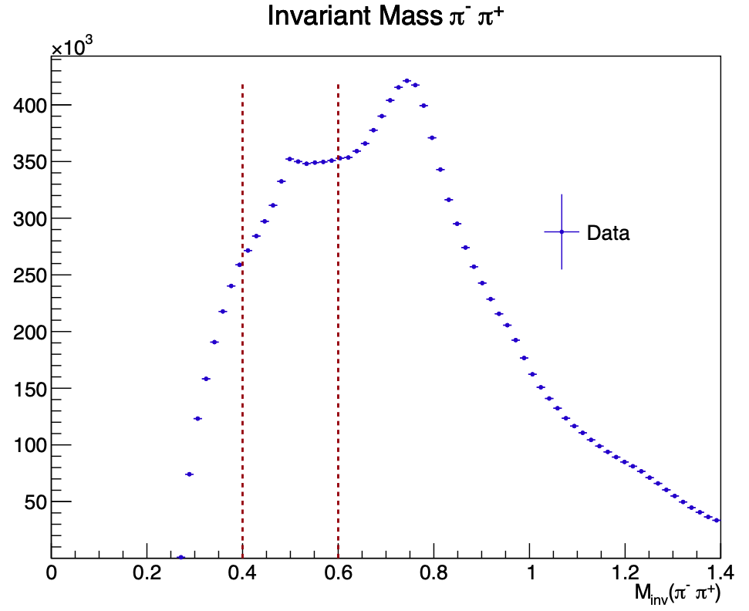
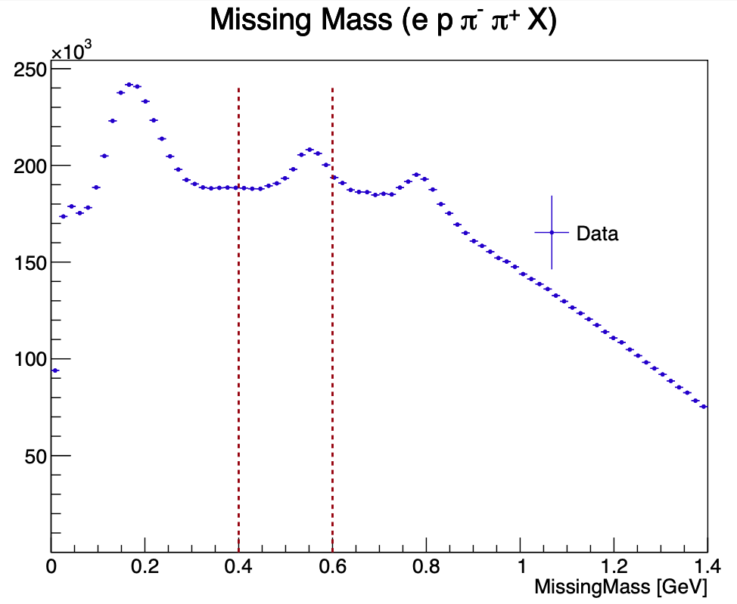
Details of cuts on datas
Mathieu Ronayette
4/26
Mathieu Ronayette
rgA - meeting
21 Jan 2026

Slide 5
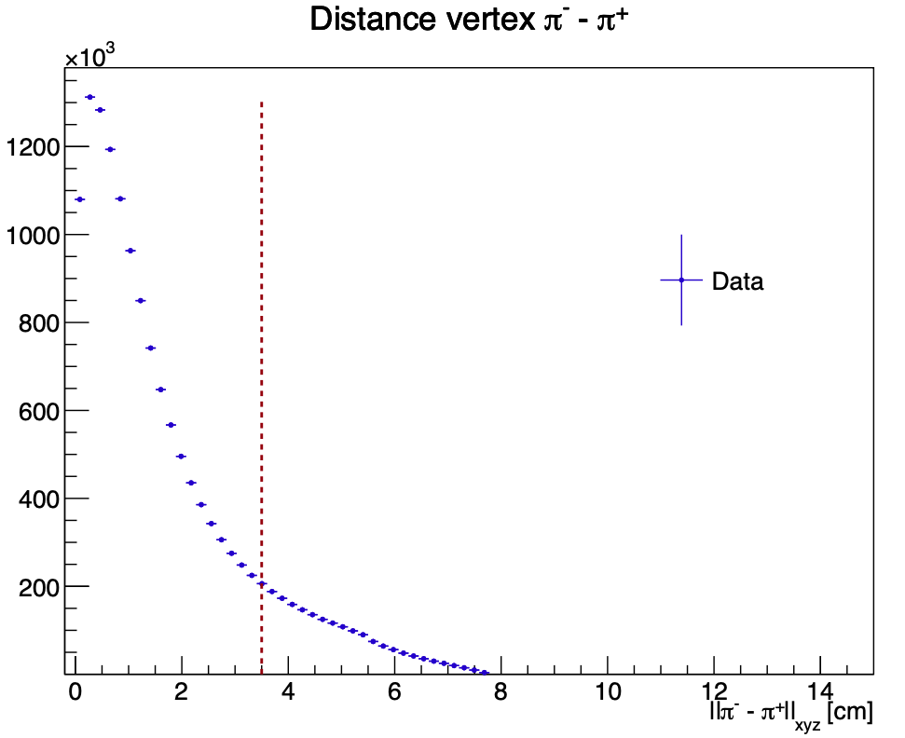
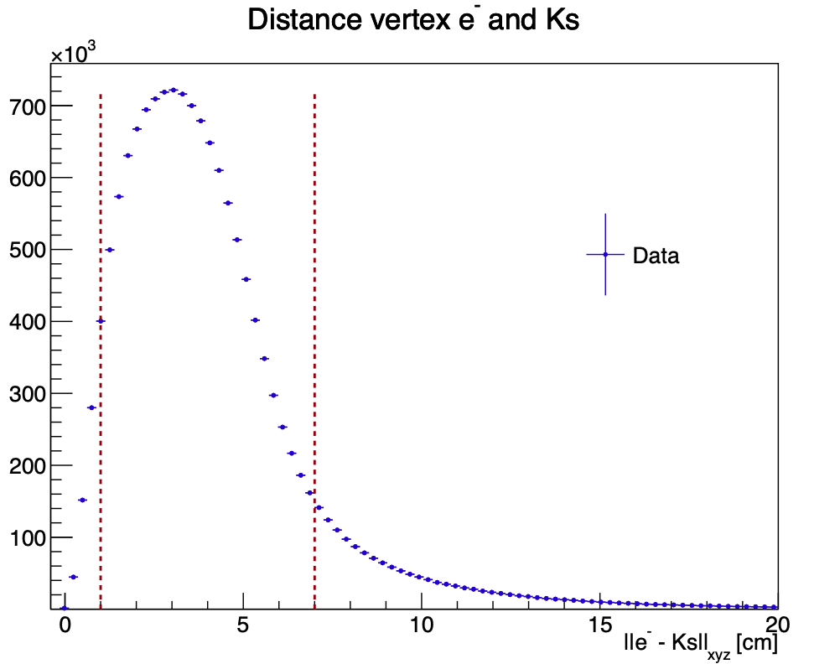
Details of cuts on datas
Mathieu Ronayette
5/26
Mathieu Ronayette
rgA - meeting
21 Jan 2026

Slide 6
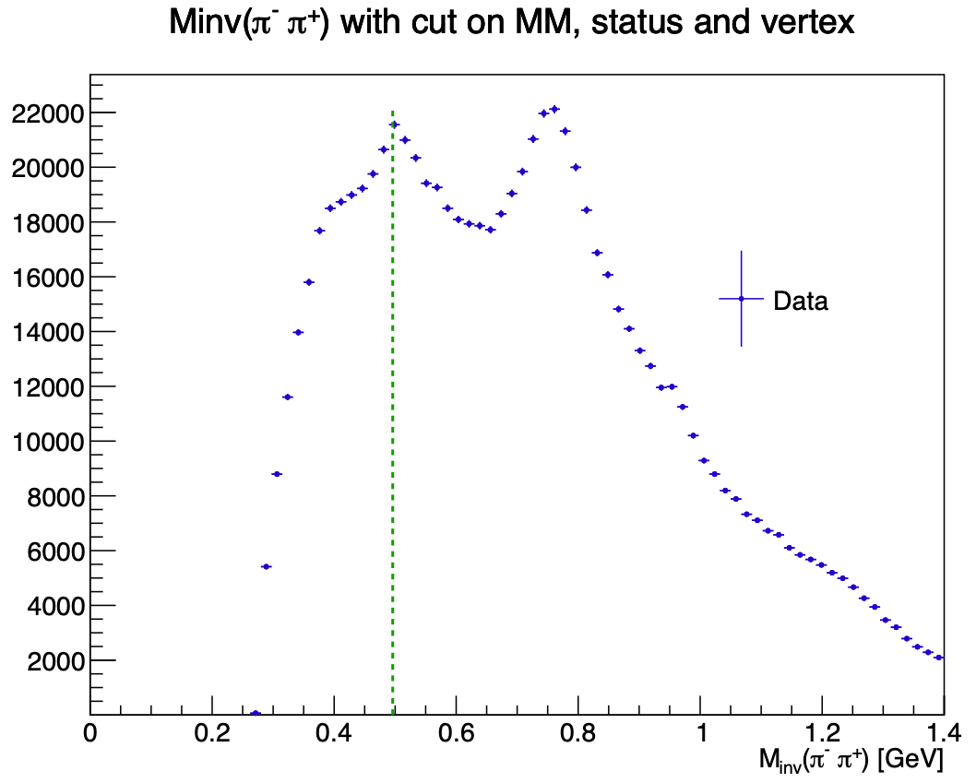
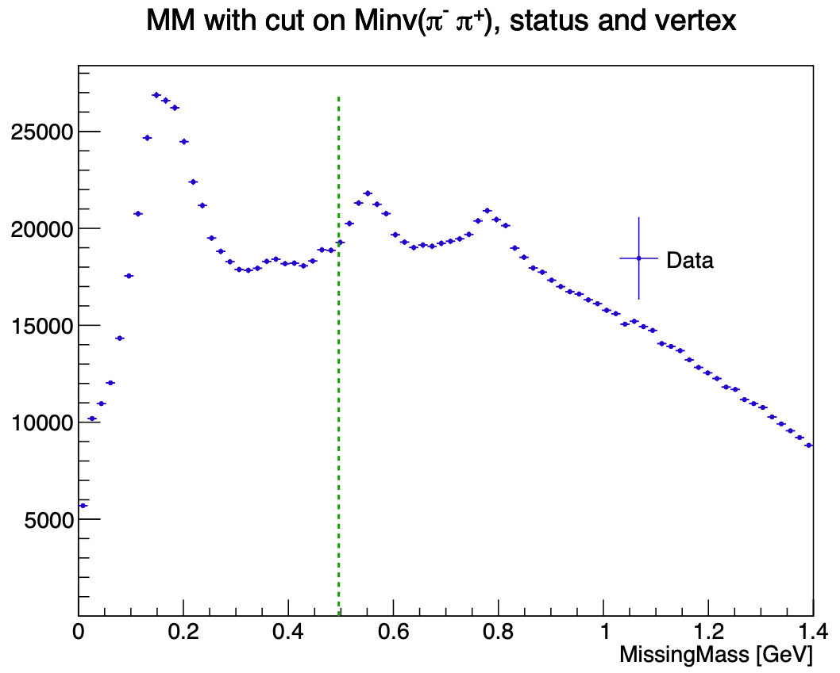
Influence of cuts on datas
Mathieu Ronayette
6/26
Mathieu Ronayette
rgA - meeting
21 Jan 2026

Slide 7
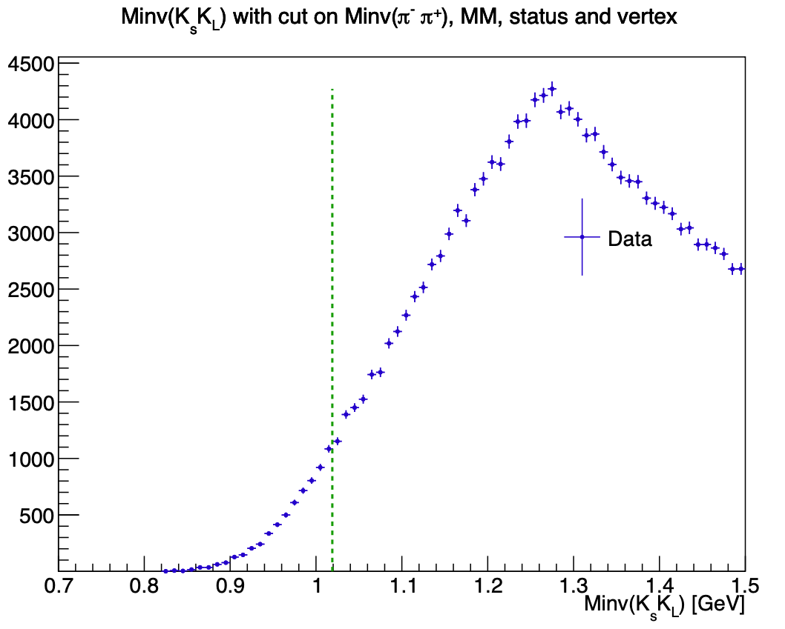
Influence of cuts on datas
Mathieu Ronayette
7/26
Mathieu Ronayette
rgA - meeting
21 Jan 2026

Slide 8
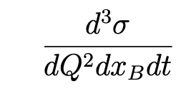
Simulation Monte Carlo : ɸ generator
From Proposal to Jeﬀerson Lab PAC39 Exclusive Phi Meson Electroproduction with CLAS12
Branching ratio Ks → π⁺ π⁻ = 69%
Branching ratio ɸ → Ks Kl = 34%
Mathieu Ronayette
8/26
Mathieu Ronayette
rgA - meeting
21 Jan 2026

Slide 9
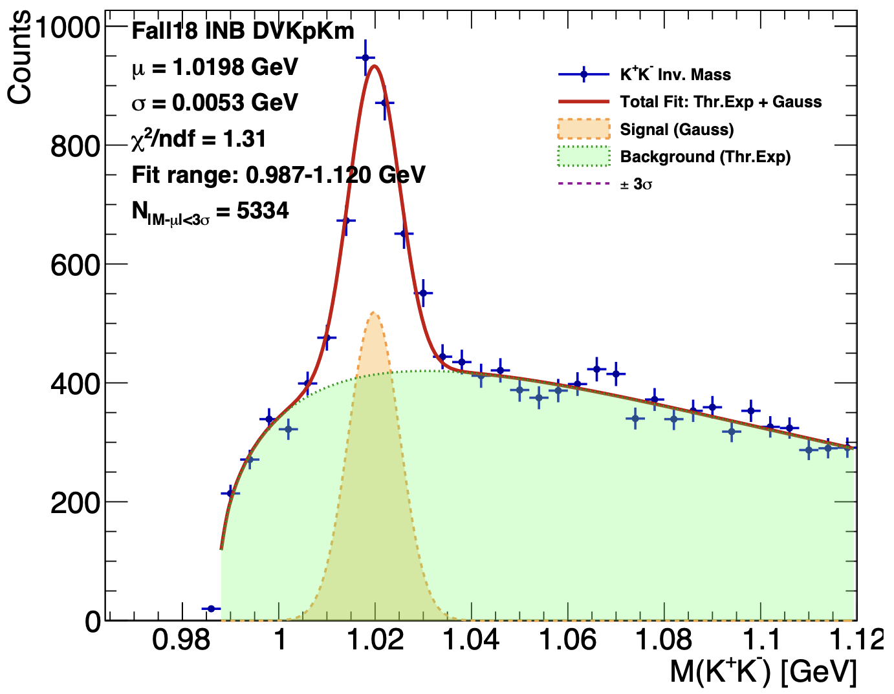
Simulation Monte Carlo : Validation with ɸ → K+ K-
→ Test my Monte Carlo with a ɸ electroproduction channel wich there is a signal : ɸ → K+ K-
e
e’
K+
q
ɸ
K-
p
p’
Bhawani’s plot
Mathieu Ronayette
9/26
Mathieu Ronayette
rgA - meeting
21 Jan 2026

Slide 10
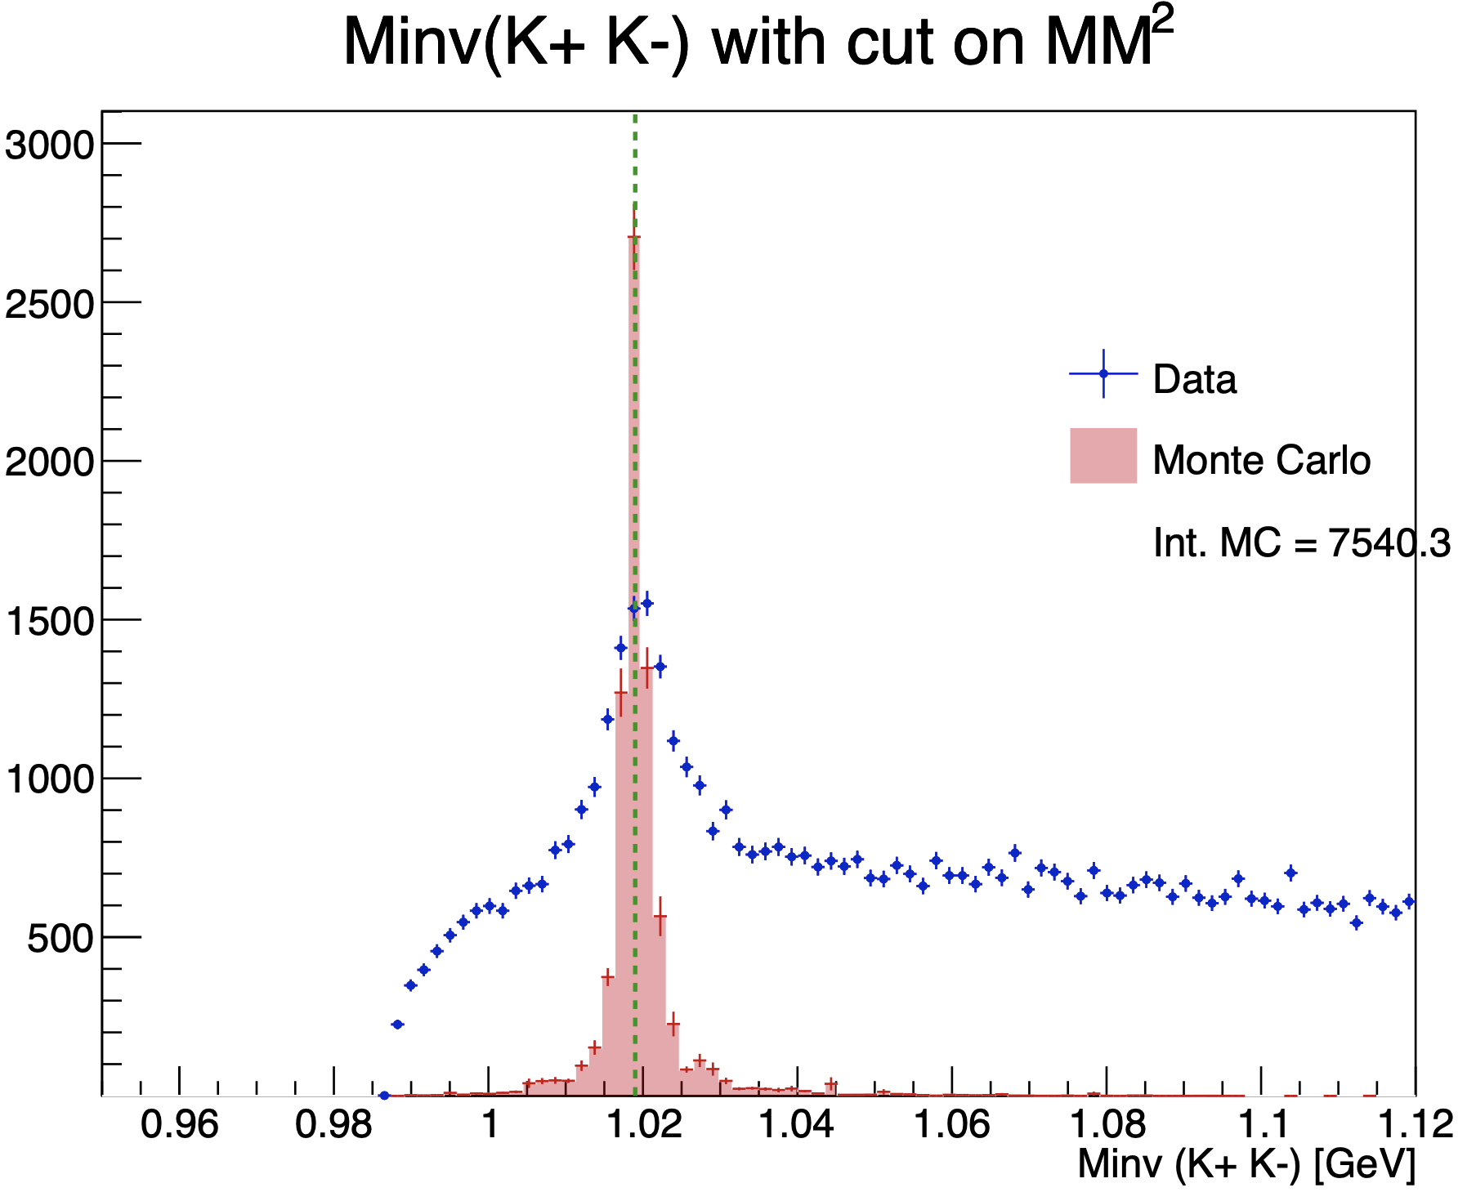
Simulation Monte Carlo : Validation with ɸ → K+ K-
Bhawani’s plot
Mathieu Ronayette
10/26
Mathieu Ronayette
rgA - meeting
21 Jan 2026

Slide 11
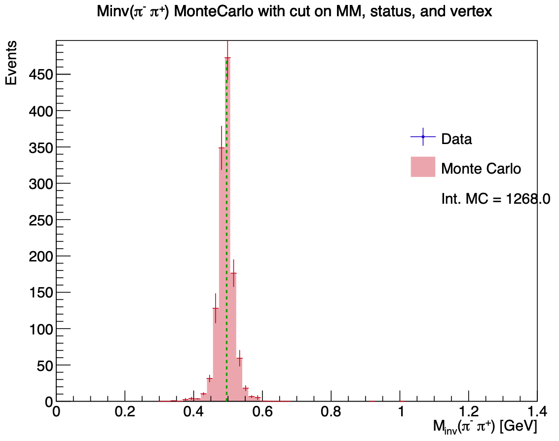
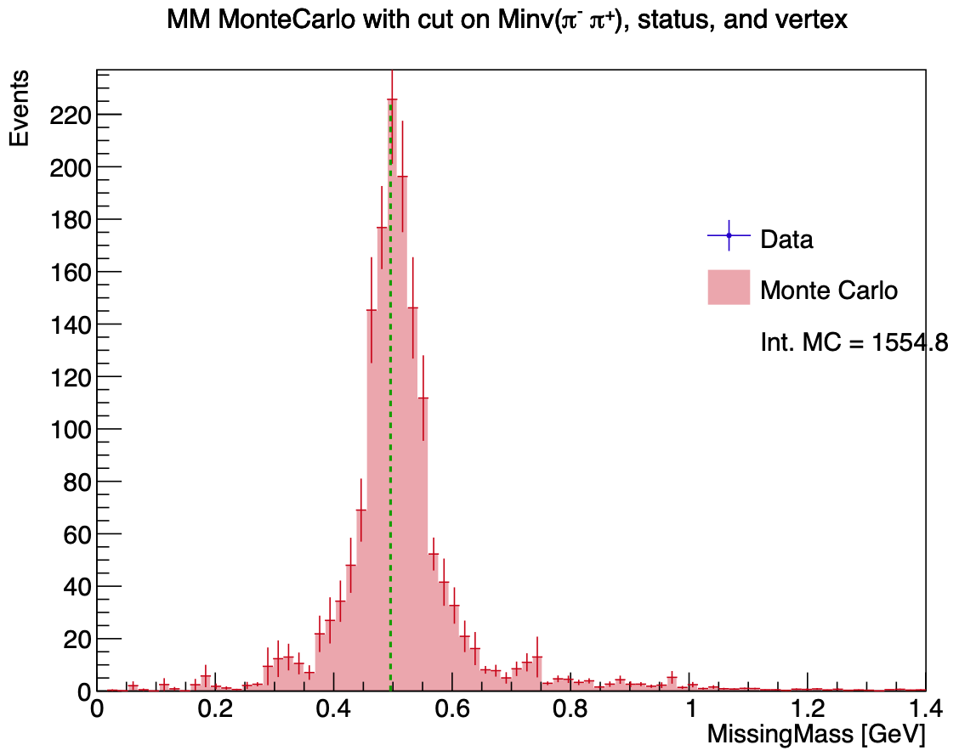
Simulation Monte Carlo : events reconstructed
Mathieu Ronayette
11/26
Mathieu Ronayette
rgA - meeting
21 Jan 2026

Slide 12
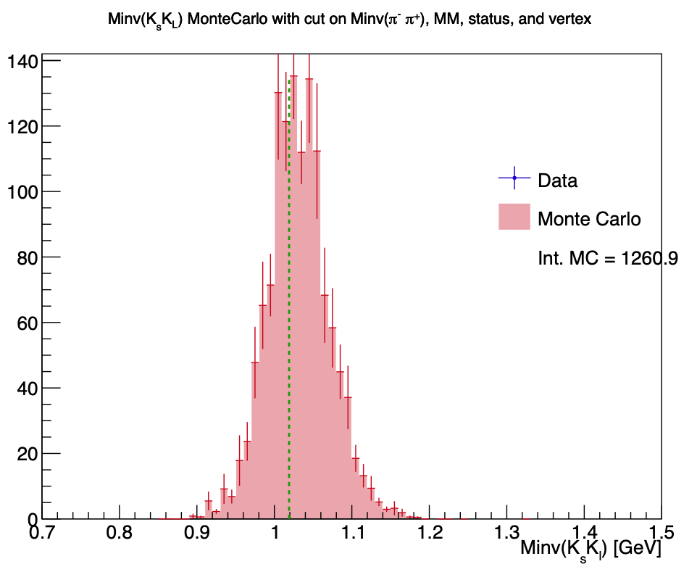
Simulation Monte Carlo : events reconstructed
Mathieu Ronayette
12/26
Mathieu Ronayette
rgA - meeting
21 Jan 2026

Slide 13
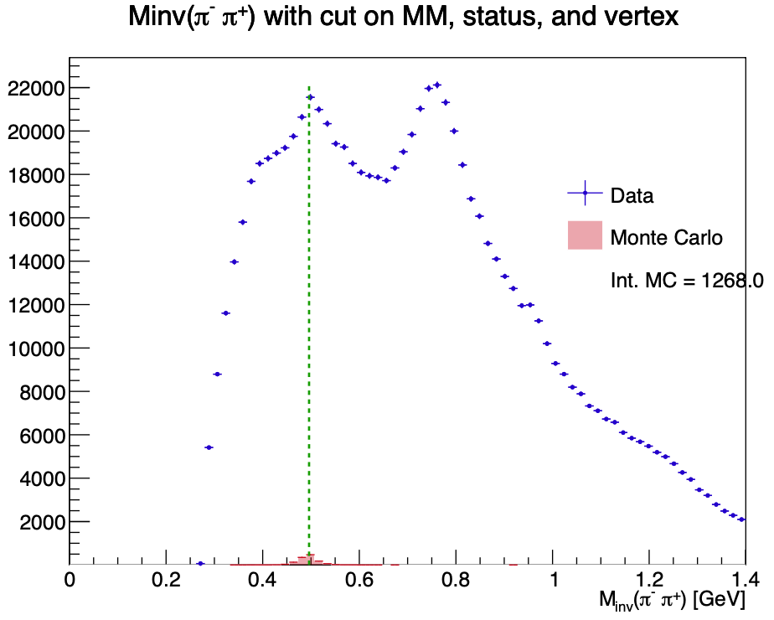
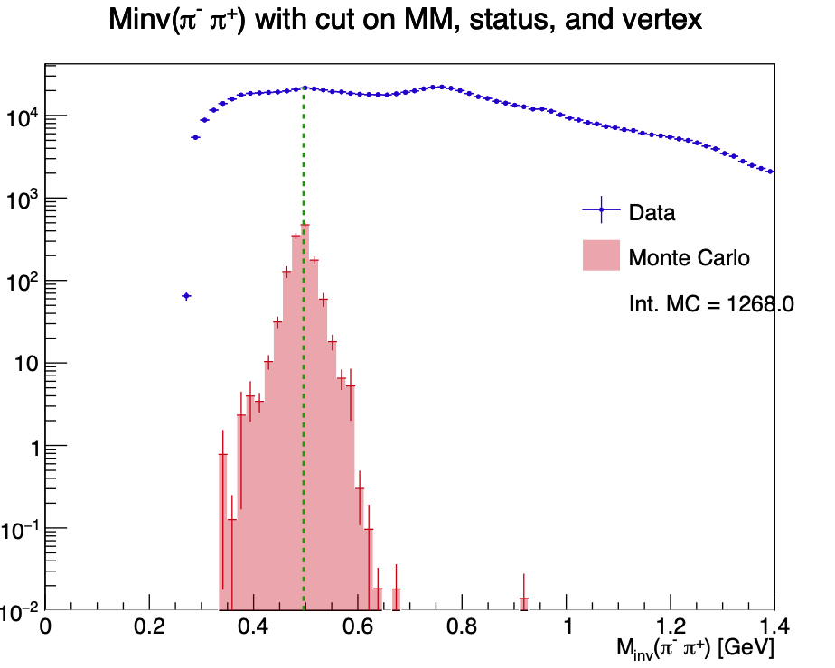
Simulation Monte Carlo : comparison with datas
Mathieu Ronayette
13/26
Mathieu Ronayette
rgA - meeting
21 Jan 2026

Slide 14
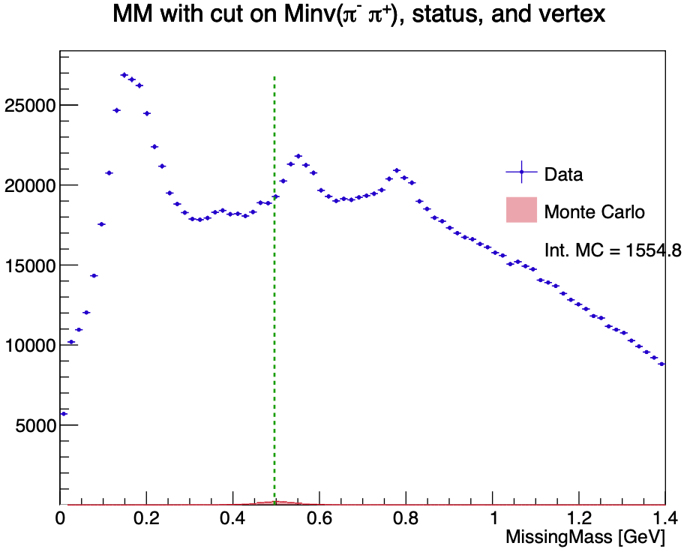
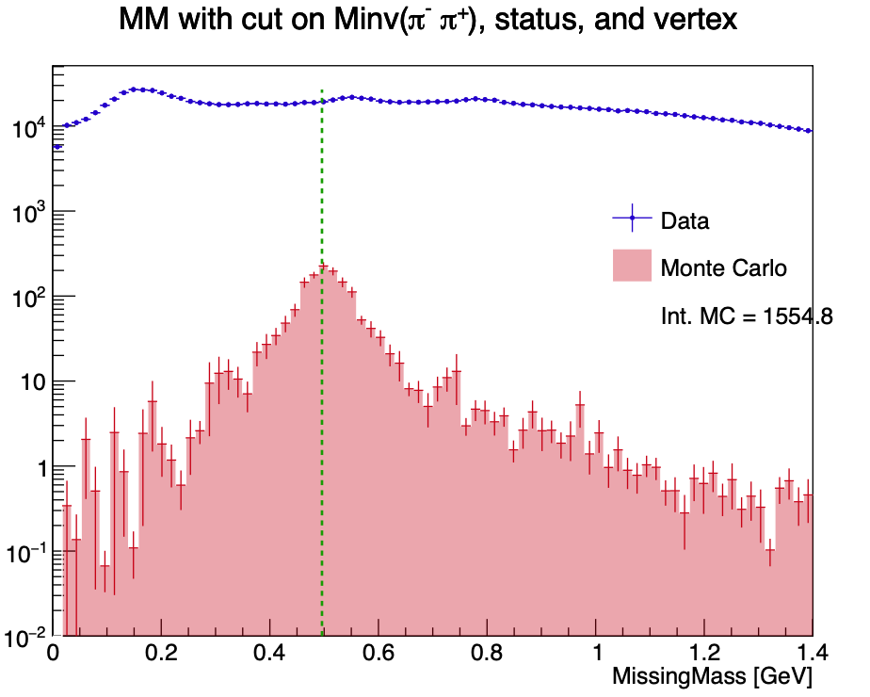
Simulation Monte Carlo : comparison with datas
Mathieu Ronayette
14/26
Mathieu Ronayette
rgA - meeting
21 Jan 2026

Slide 15
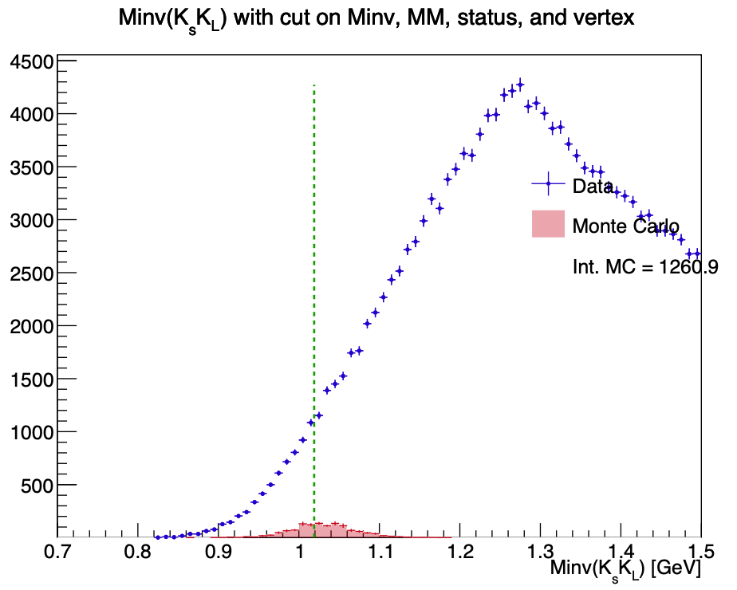
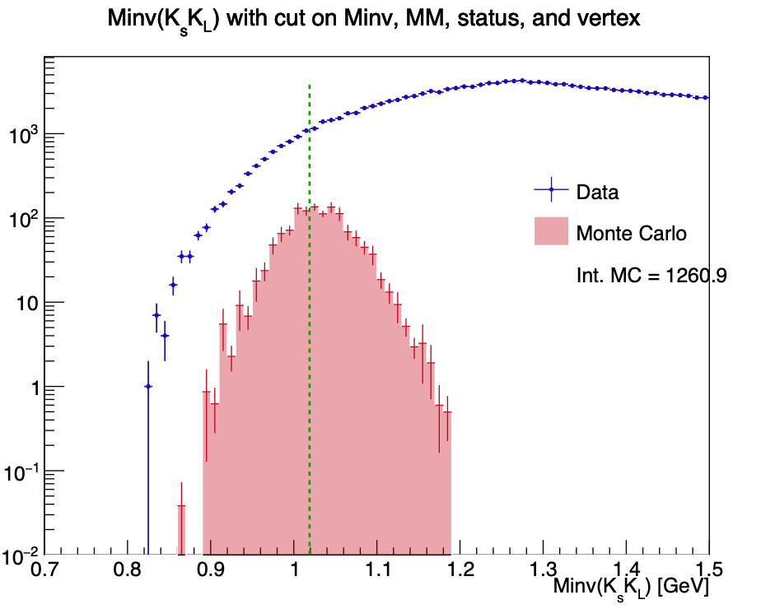
Simulation Monte Carlo : comparison with datas
Mathieu Ronayette
15/26
Mathieu Ronayette
rgA - meeting
21 Jan 2026

Slide 16
Simulation Monte Carlo : comparison with datas
→ MC predicte a problem on acceptance and resolution
Mathieu Ronayette
16/26
Mathieu Ronayette
rgA - meeting
21 Jan 2026

Slide 17
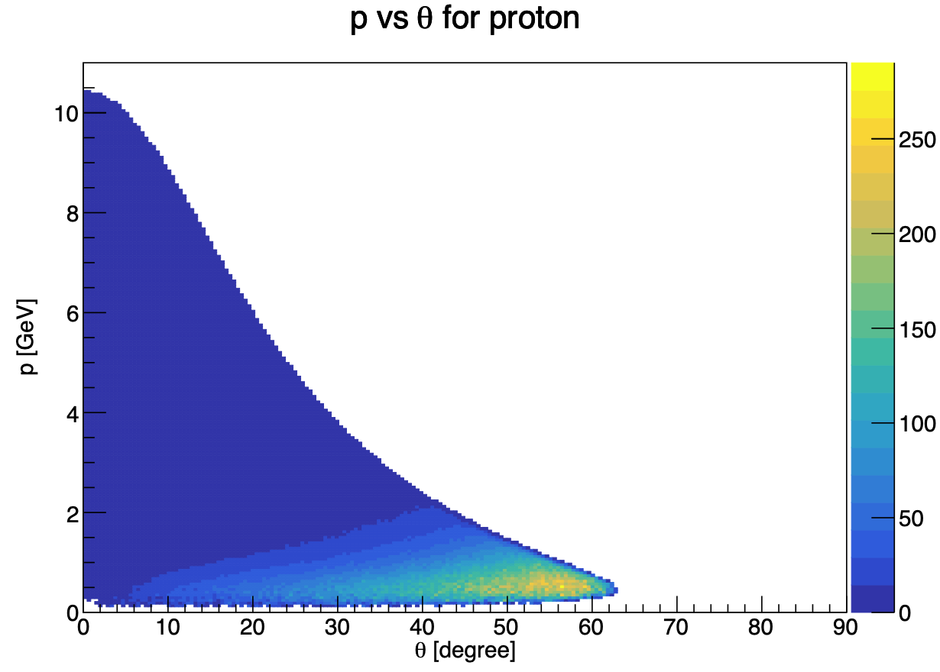
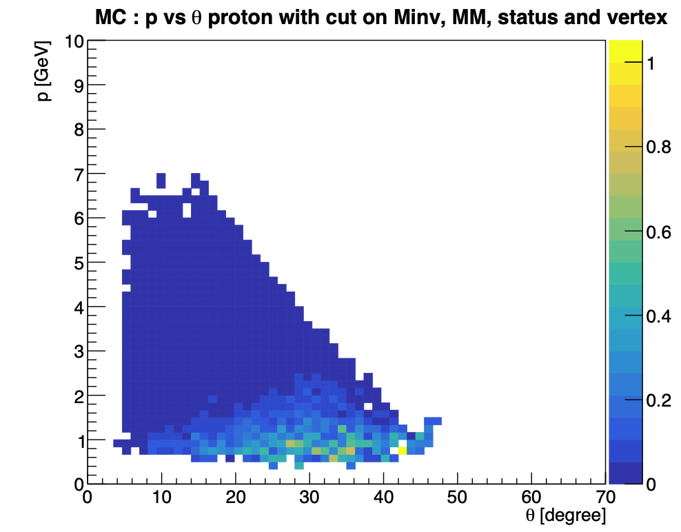
Simulation Monte Carlo : comparison generated/reconstructed
Events generated
Events MC reconstructed (after cuts)
Mathieu Ronayette
17/26
Mathieu Ronayette
rgA - meeting
21 Jan 2026

Slide 18
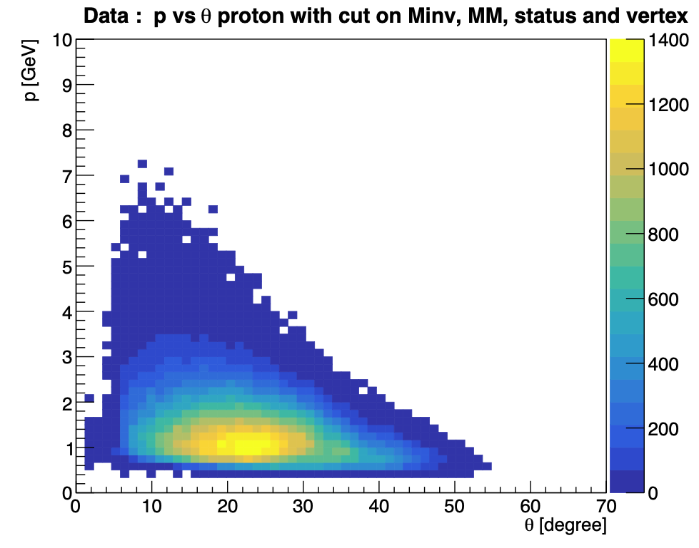
Simulation Monte Carlo : comparison generated/reconstructed
Events generated
Events from data (after cuts)
Mathieu Ronayette
18/26
Mathieu Ronayette
rgA - meeting
21 Jan 2026

Slide 19
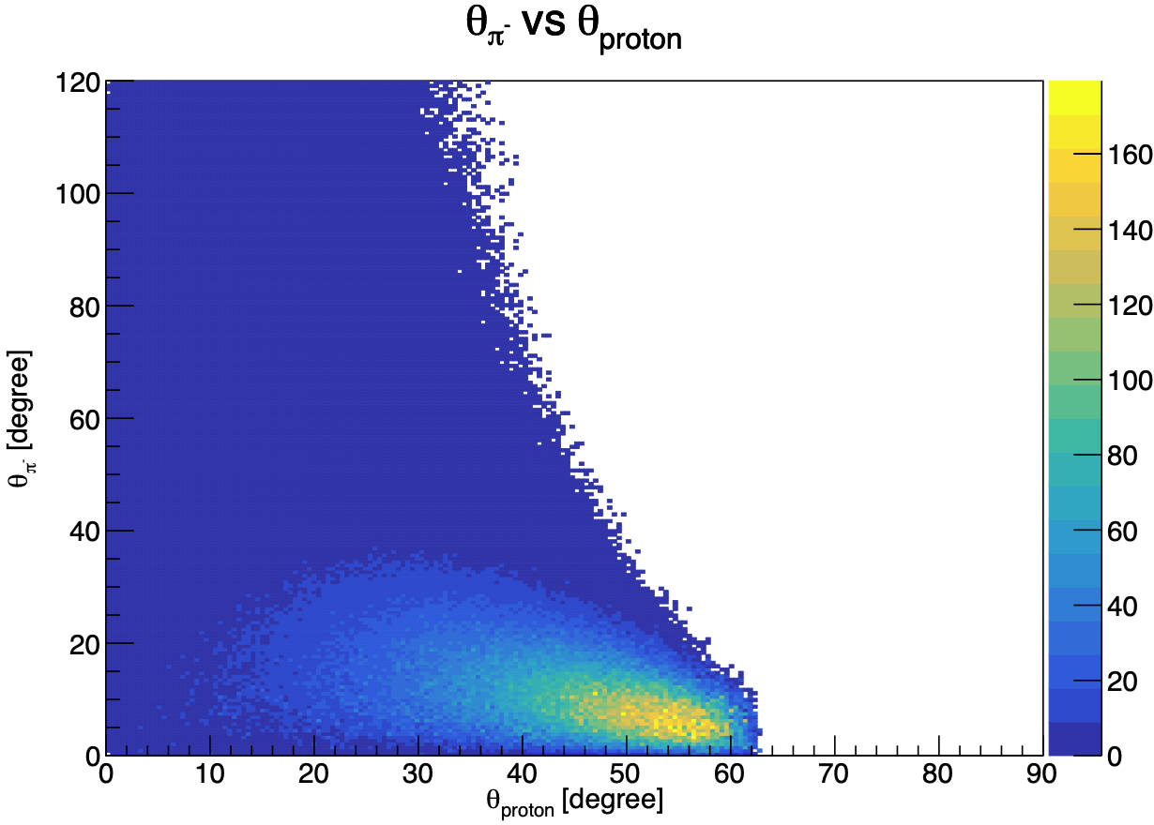
Simulation Monte Carlo : comparison generated/reconstructed
Events generated
(same figure with π⁺)
Mathieu Ronayette
19/26
Mathieu Ronayette
rgA - meeting
21 Jan 2026

Slide 20
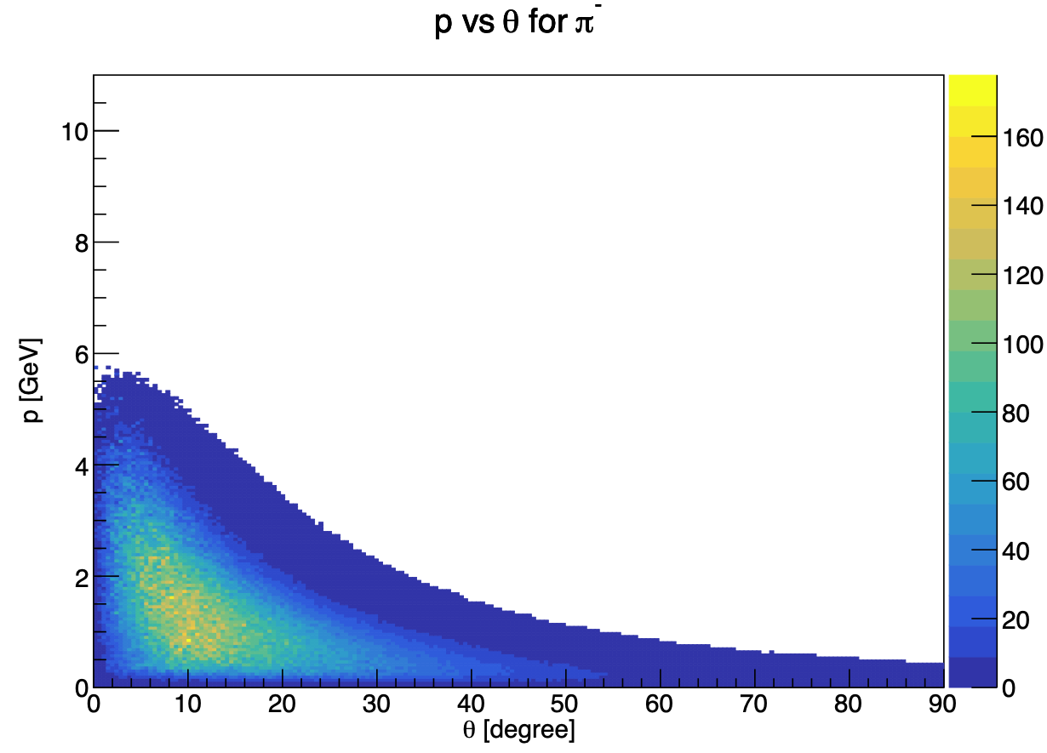
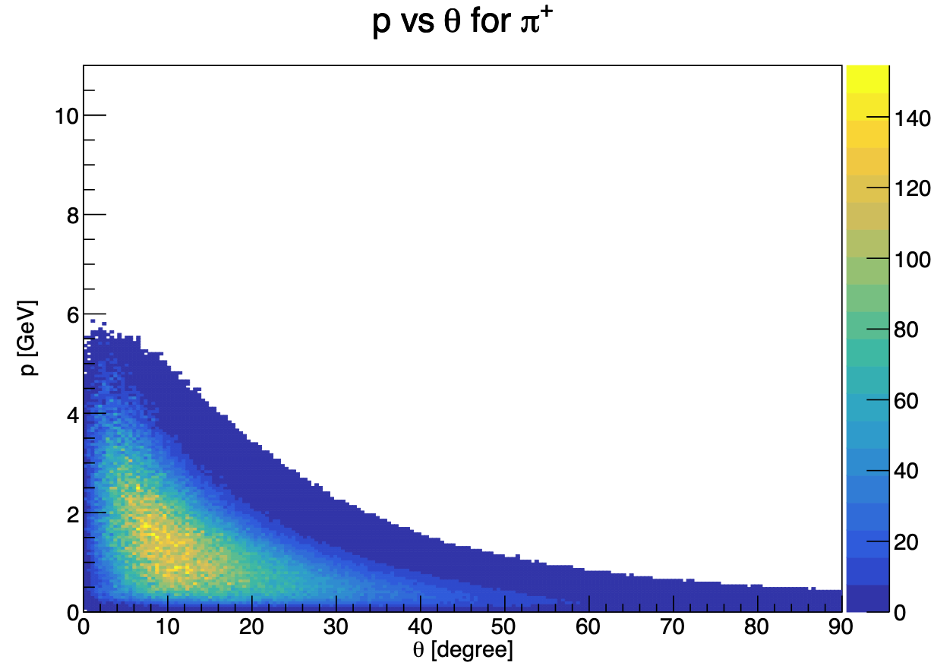
Simulation Monte Carlo : comparison generated/reconstructed
Events generated
Mathieu Ronayette
20/26
Mathieu Ronayette
rgA - meeting
21 Jan 2026

Slide 21
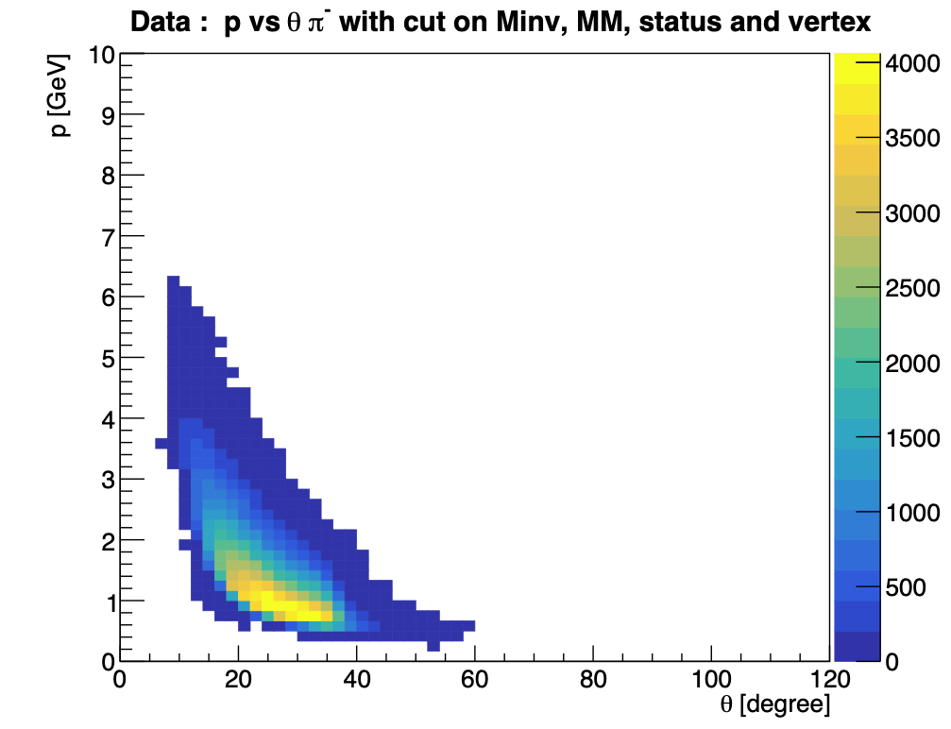
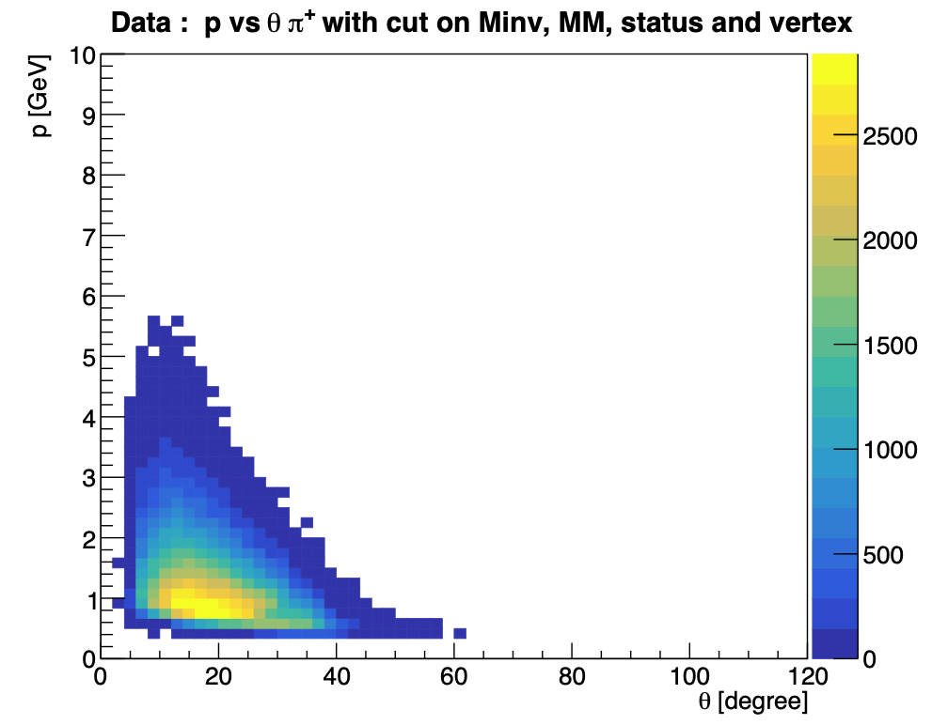
Simulation Monte Carlo : comparison generated/reconstructed
DATA Inbending
Mathieu Ronayette
21/26
Mathieu Ronayette
rgA - meeting
21 Jan 2026

Slide 22
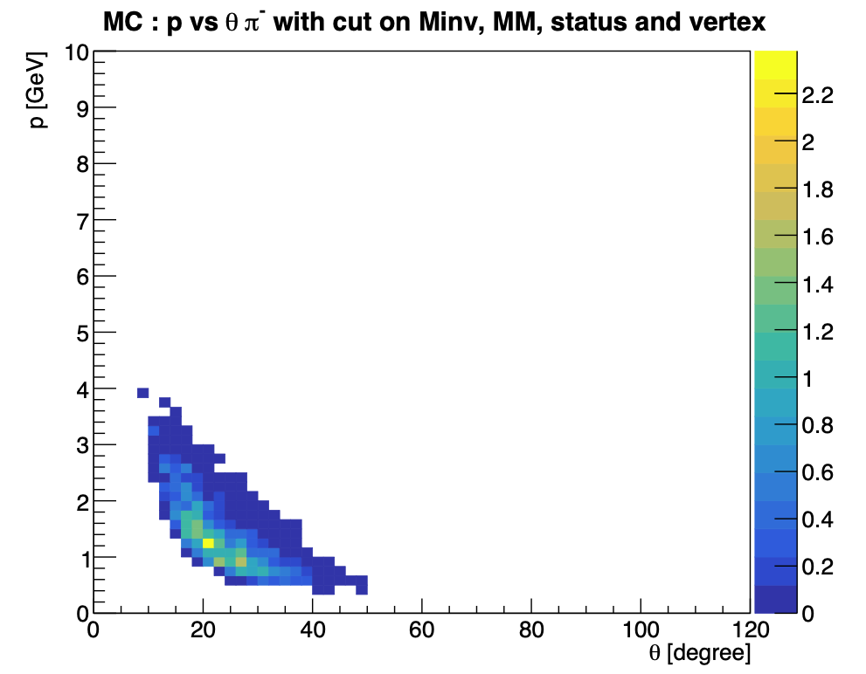
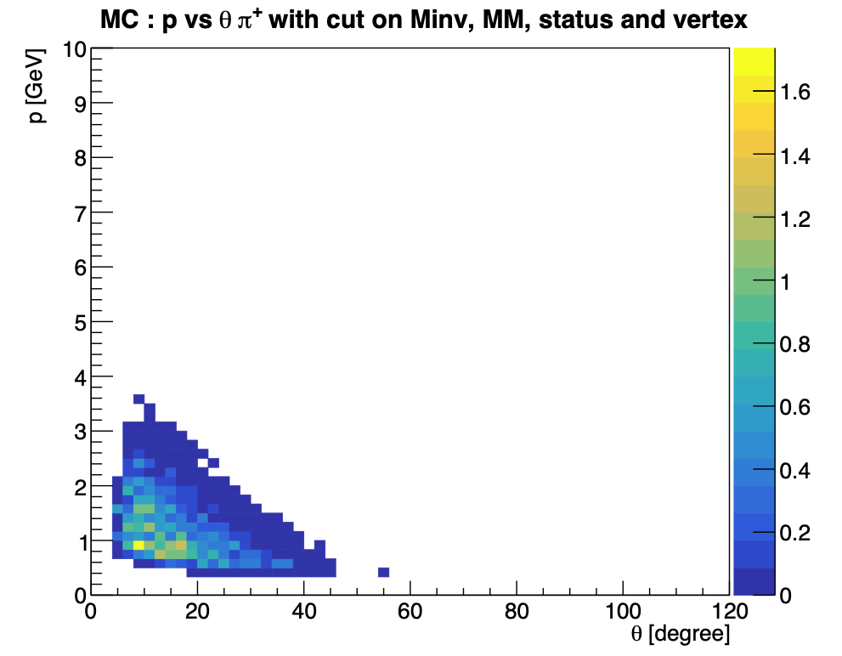
Simulation Monte Carlo : comparison generated/reconstructed
MC Inbending
Mathieu Ronayette
22/26
Mathieu Ronayette
rgA - meeting
22 Jan 2025

Slide 23
Pions in the FT ?
For inbending : events with 1 proton 1 π ⁺ and 2 e⁻
→ one e⁻ in the FD (real e⁻)
→ one e⁻ in the FT (π – identified like an e⁻)
For outbending : events with 1 proton 1 π ⁻ and 2 e⁻
→ one e⁻ in the FD (real e⁻)
→ one e⁻ in the FT (π ⁺ identified like an e⁻)
No correction with veronique zigler code
→ no cuts on vertex
Mathieu Ronayette
23/26
Mathieu Ronayette
rgA - meeting
23 Jan 2026

Slide 24


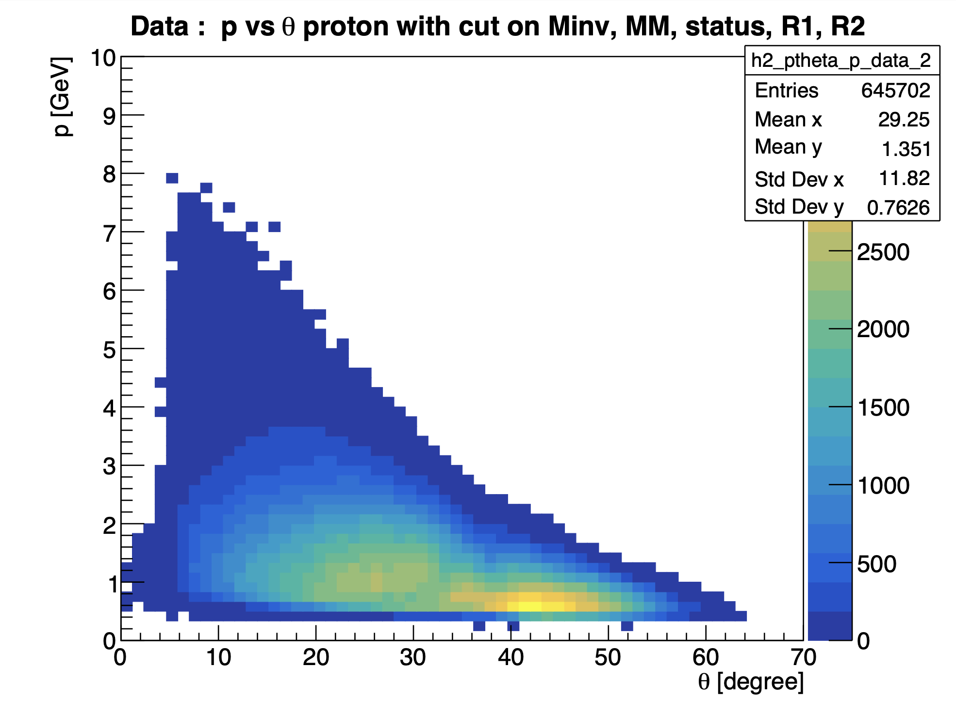
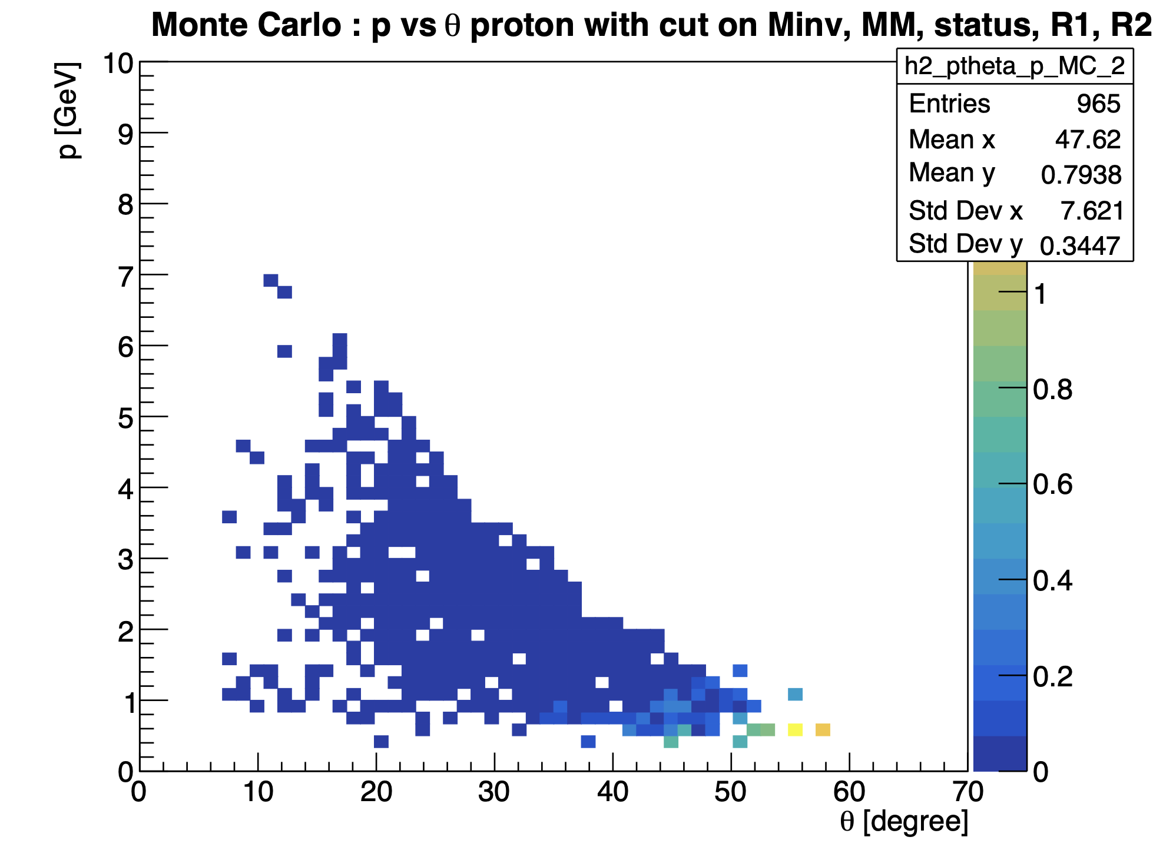
Pions in the FT ?
inbending
Mathieu Ronayette
24/26
Mathieu Ronayette
rgA - meeting
21 Jan 2026

Slide 25
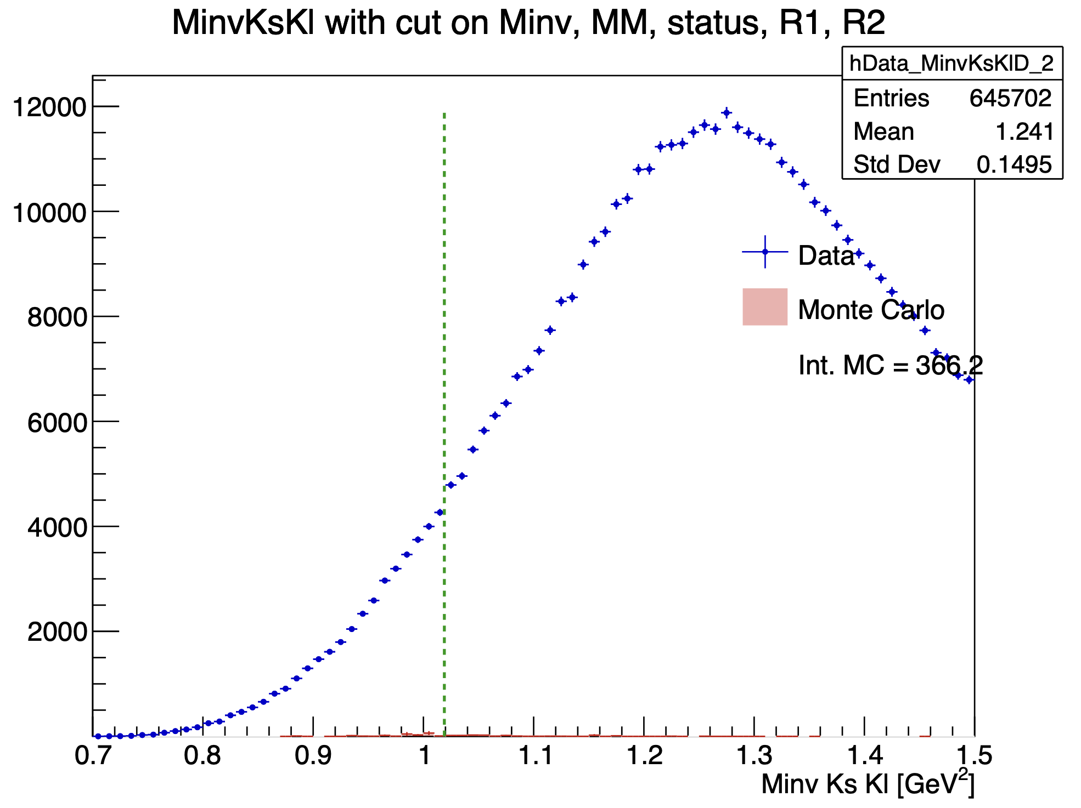
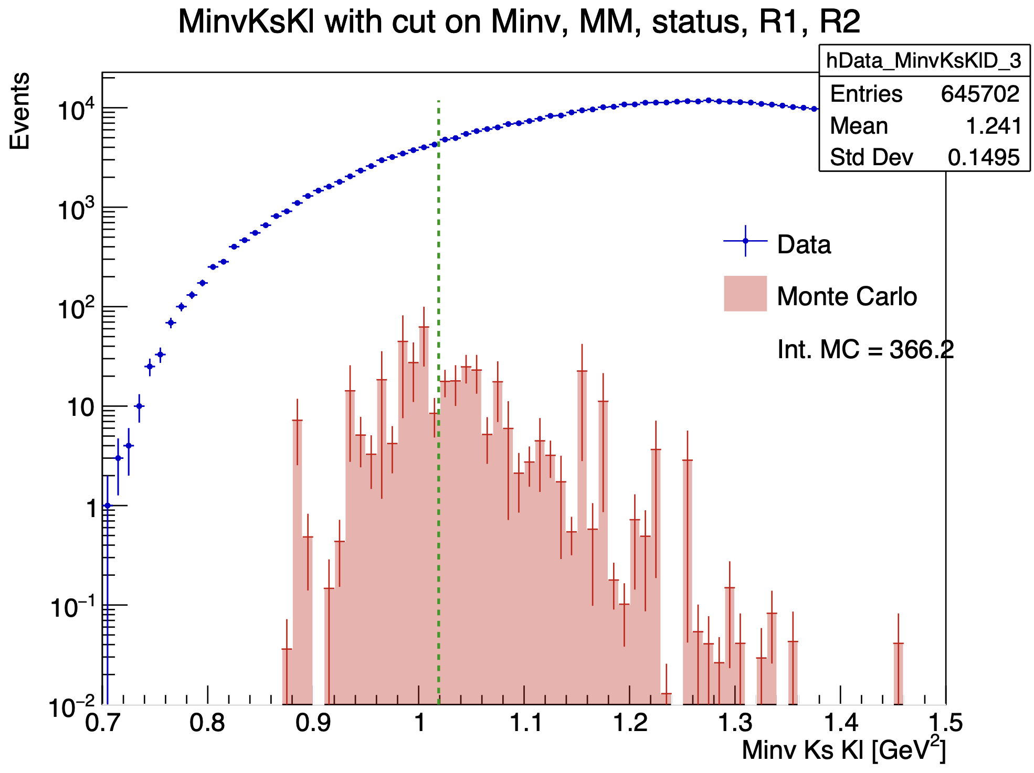
Pions in the FT ?
inbending
Mathieu Ronayette
25/26
Mathieu Ronayette
rgA - meeting
21 Jan 2026

Slide 26
Conclusion
Conclusion :
We don’t see signal in Ks Kl channel because of problems on pions acceptance and process resolution.
→ For the resolution : we can develop a kinematic fitter ?
→ For the acceptance : we try to detect pions in the FT but we have very poor efficiency (maybe because pions don’t depose energy in the FT calorimeter so they are no detected)
Thanks!
Mathieu Ronayette
26/26
Mathieu Ronayette
rgA - meeting
21 Jan 2026

